Slide 2
Objectives
Define Windows Presentation Foundation (WPF)
Explain WPF architecture
Describe XAML, its basic structure, and its role in WPF applications
Describe the controls in WPF
Describe the process of using styles and transforms in WPF applications
Describe the graphics and animation features in WPF
Explain WPF user controls

Slide 3

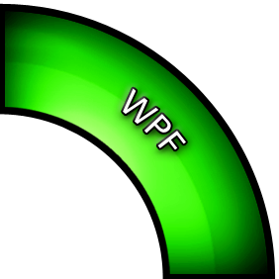




Windows Presentation Foundation 2-3
A productive, unified approach to UI, media and documents to deliver unmatched user experience

Slide 4
Windows Presentation Foundation 3-3
Creates, displays, and manipulates user interfaces, documents, images, movies, and media
Supports two-dimensional and three-dimensional graphics, animation, video, and different kinds of documents
Provides a common foundation for desktop and browser clients
Introduces a new markup language, Extensible Application Markup Language (XAML)
Creates user interfaces using markup and programming codes

Slide 5
Features of WPF
Resolution Independence
Animation
2D and 3D Graphics
New markup Language – XAML
Data Binding
Video and Audio Elements

Slide 6
Extensible Application Markup Language (XAML)
A markup language based on XML for declarative application programming
Features
UI and Business Logic Separation
High User Experience
Easier Extension
Easier to implement Styles for UI

Slide 7
Basic Structure of XAML 1-2
A WPF stand-alone application contains windows or pages
Window is a top-level window with the <Window> tag
Page is a browser-hosted page with the <Page> tag in an XAML file
XAML has ResourceDictionary and Application root elements for specifying the external dictionary and application definition

Slide 8
Basic Structure of XAML 2-2
Syntax
<Window x:Class="WpfApplication1.Window1"
xmlns="http://schemas.microsoft.com/winfx/2006/xaml/presentation"
xmlns:x="http://schemas.microsoft.com/winfx/2006/xaml"
Title="Window1" Height="300" Width="300">
<Grid>
……………………………………………
……………………………………………
</Grid>
</Window>
where,
Window: One of commonly used root element which contains other elements
xmlns: Namespace declared specifically for WPF
xmlns:x: Namespace with keywords and markup extensions in XAML. It includes mapping with the x: prefix

Slide 9
Attributes
Assigns the names for an event or value to the property
Two types:
Property Attribute which defines properties for the element
Event Attribute which specifies handler for the element
Syntax
<...attribute_name="value"...>

Slide 10
Elements
An XAML element instantiates a .NET Common Language Runtime (CLR) class
Two types:
Property element enables to assign other element as a value of a property
Event element handles an event of the control
Syntax – Property Element
<typeName.propertyName>...</typeName.propertyName >
Syntax – Event Element
<typeName event="event handler">...</ typeName>

Slide 11
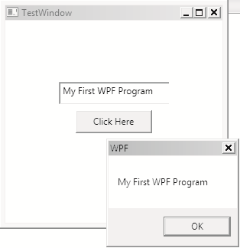
Attributes and Elements - Example
C# Code
Output
The following example demonstrates the use of attributes and elements in a WPF application.
XAML Code

Slide 12
namespace XAMLApplication
{
/// <summary>
/// Interaction logic for TestWindow.xaml
/// </summary>
public partial class TestWindow : Window
{
public TestWindow()
{
InitializeComponent();
}
private void btnTest_Click(object sender, RoutedEventArgs e)
{
MessageBox.Show(txtName.Text, "WPF");
}
}
}

Slide 13
<Window x:Class="XAMLApplication.TestWindow"
xmlns="http://schemas.microsoft.com/winfx/2006/xaml/presentation"
xmlns:x="http://schemas.microsoft.com/winfx/2006/xaml"
Title="TestWindow" Height="300" Width="300">
<Grid>
<TextBox Name="txtName" >
<TextBox.VerticalAlignment>Top</TextBox.VerticalAlignment>
<TextBox.Margin>70,80</TextBox.Margin>
<TextBox.Height>30</TextBox.Height>
<TextBox.Width>150</TextBox.Width>
</TextBox>
<Button Name="btnTest" Click="btnTest_Click">
<Button.Height>30</Button.Height>
<Button.Width>100</Button.Width>
<Button.Content>Click Here</Button.Content>
</Button>
</Grid>
</Window>

Slide 14
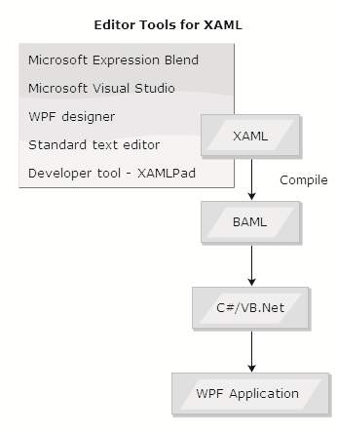
WPF Application – Compilation Process

Slide 15
Routed Events
Logical and visual trees for the code
A visual tree in WPF is the hierarchy of visible layers in a user interface
A logical tree describes the relations between elements of the user interface
Snippet
<Window>
<Grid>
<Button Content="Button" />
<Label Content="Label" />
</Grid>
</Window>

Slide 16
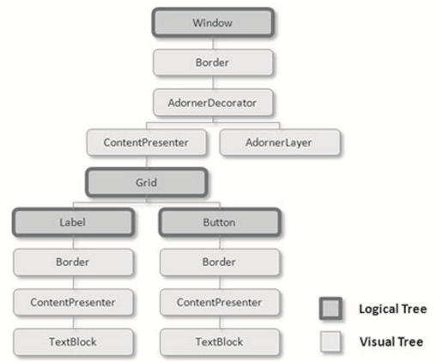

Slide 17
WPF Controls
Category | Controls
Layout | Border, Canvas, DockPanel, Grid, GroupBox, Panel, ResizeGrip, Separator, ScrollBar, ScrollViewer, StackPanel, Thumb, Viewbox
Buttons | Button, RepeatButton
Menus | ContextMenu, Menu, ToolBar
Selection | CheckBox, ComboBox, ListBox, ListView, TreeView, RadioButton
Navigation | Frame, Hyperlink, Page, NavigationWindow, TabControl
Input | TextBox, RichTextBox, PasswordBox
User Information | AccessText, Label, Popup, ProgressBar, StatusBar, TextBlock, ToolTip
Media | Image, MediaElement, SoundPlayerAction

Slide 18
Basic Controls - Example
The example creates a Label, TextBox, Button, and an Image.
Output
Snippet
<Grid>
<Label Content="Name:" Margin="13,31,0,0" Height="28"
HorizontalAlignment="Left" VerticalAlignment="Top" Width="52"/>
<TextBox Name="txtName" Margin="69,33,113,0" Height="30"
VerticalAlignment="Top">
This is a TextBox.
</TextBox >
<Button Name="btnClick" Content="Click Me"
Margin="69,85,113,0" Height="30" VerticalAlignment="Top" />
<Image Name="imgPhoto" Source="c:\\test.jpg"
Margin="95,126,126,100">
</Image>
</Grid>

Slide 19
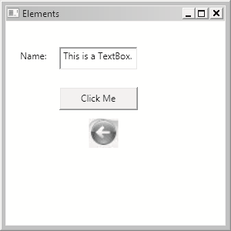

Slide 20
Container Controls
Dynamic layout functionality is achieved through container controls
Canvas, Grid, and DockPanel are some of the container controls in WPF
The Canvas control handles absolute x and y positions and layout for its contained controls

Slide 21
The example creates a canvas containing Path controls – Bezier curve
Snippet
<Canvas Height="290" Width="29 Background="Aquamarine">
<Path Data="M 10,100 C 10,0 200,200 300,100 z"
Stroke="Black"
StrokeThickness="4"
Fill="Blue"/>
</Canvas>

Slide 22

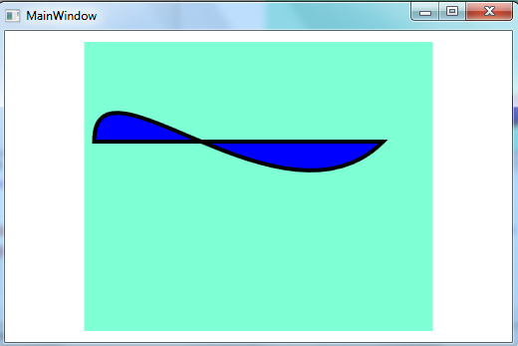

Slide 23
Radial Gradient
Snippet
<Grid Width="264" Height="108" Background="Wheat" >
<Rectangle Width="200" Height="150" Margin="228,10,75,152">
<Rectangle.Fill>
<RadialGradientBrush>
<GradientStop Color="Yellow" Offset="0"/>
<GradientStop Color="Red" Offset="0.25"/>
<GradientStop Color="Blue" Offset="0.75"/>
</RadialGradientBrush>
</Rectangle.Fill>
</Rectangle>
Margin="10,0,0,-38" />
</Grid>

Slide 24
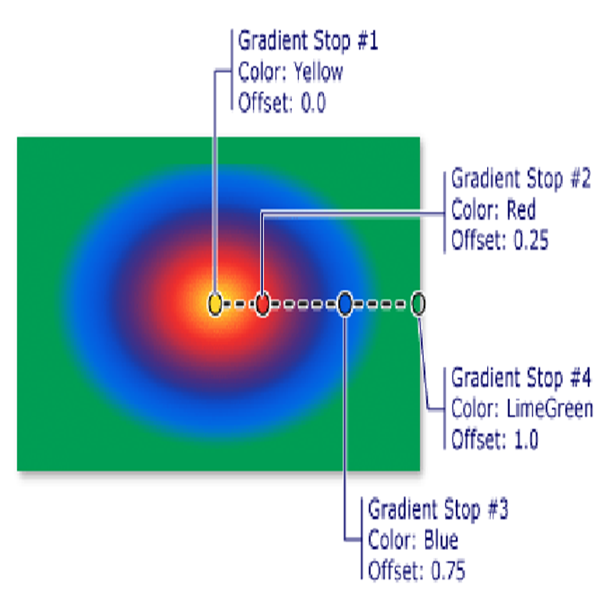
Output

Slide 25
Styles in WPF
Category | Controls
BasedOn | Specifies or retrieves a base style
Dispatcher | Retrieves the Dispatcher inherited from DispatcherObject
IsSealed | Used to check whether the style is read-only or not
Resources | Specifies or retrieves the collection of resources that can be used within the scope of this style
TargetType | Specifies or retrieves the type for which this style is intended
Setters | Retrieves a collection of Setter and EventSetter objects
Triggers | Retrieves a collection of TriggerBase objects that apply property values based on given conditions

Slide 26
Types of Styles
Three types of styles: inline, named, and element
Inline Styles
Applies a unique style to a control
Uses the Style property
Named Styles
Defined by adding inline styles into resources
Has a name which is later used in control instances
Element Styles
Applies a style consistently to all instances of a particular type of control

Slide 27
Transforms
Provides different alteration to the object
Provides mapping of object points from one coordinate space to another
Rotation Transforms
Rotates an object in X-Y positions
Scale Transforms
Scales an object starting from specific center point
Skew Transforms
Skews/Slants an object by defines x-axis and y-axis angle
Translate Transforms
Translates the WPF object in the two-dimensional plane

Slide 28
Animations
An object is animated by actions such as rotating, moving, changing size and color, and compressing
Types of Animations
<Type>Animation
<Type>AnimationUsingKeyFrames
<Type>AnimationUsingPath
<Type>AnimationBaseScale Transforms

Slide 29
Graphics
WPF supports creation of 2D and 3D vector graphics
Tool | Description
Bitmap Effects | Applies visual effects on rendered WPF content
Brushes | Provides different types of brushes to paint user interface objects
Drawings | Allows drawing shapes, images, text, and media
Geometries | Defines the region for 2D graphics, clipping, and animating
Images | Provides a new set of components to use images within an application
Shapes | Allows user to draw basic shape to the screen

Slide 30
Example of Animation
private void animationTest()
{
DoubleAnimation da = new DoubleAnimation();
da.From = 0;
da.To = 150;
da.RepeatBehavior = RepeatBehavior.Forever;
button1.BeginAnimation(Button.HeightProperty,da);
}

Slide 31
Summary
WPF is Microsoft’s new technology used to build GUIs for the Windows platform.
WPF provides a common platform for 2D/3D graphics, animation, video, and documents which was not provided by Windows Forms or ASP.NET.
XAML is the foundation for WPF applications.
Transforms allow objects to rotate, move, and scale by using transforms classes.

